Slide 1

JSF2 Primefaces - PrimeNG
Hans Van Es

Slide 2
Agenda
Inner Circle - The Company
'JSF2 Primefaces & PrimeNG'
Length: circa 2-3h

Slide 3
JSF2-Primefaces-PrimeNG
ir. Hans Van Es
JSF2

Slide 4

JSF2
JSF2 core:
– introduced with J2EE 6
– offering a 'standard' alternative MVC framework
IMPORTANCE:
– 50% of HI10 customers use Spring-Angular
– 50% of HI10 customers use
JSF (prefer Java 'standard' stack)

Slide 5
JSF2 considerations
JSF2 implementations:
Mojarra (standard)
RichFaces
Primefaces (more recent)

Slide 6
JSF2 considerations
JSF2 Maven dependencies:
standard (Mojarra):
<dependency>
<groupId>com.sun.faces</groupId>
<artifactId>jsf-api</artifactId>
<version>2.1.7</version>
</dependency>
<dependency>
<groupId>com.sun.faces</groupId>
<artifactId>jsf-impl</artifactId>
<version>2.1.7</version>
</dependency>

Slide 7
JSF2 considerations
JSF2 Maven dependencies:
Rich Faces:
<!-- and include a BOM reference in dep mgmnt -->
<dependency>
<groupId>org.richfaces.ui</groupId>
<artifactId>richfaces-components-ui</artifactId>
</dependency>
<dependency>
<groupId>org.richfaces.core</groupId>
<artifactId>richfaces-core-impl</artifactId>
</dependency>

Slide 8
JSF2 considerations
JSF2 Maven dependencies:
Primefaces:
<dependency>
<groupId>org.primefaces</groupId>
<artifactId>primefaces</artifactId>
<version>3.3</version>
</dependency>
<dependency>
<groupId>com.sun.faces</groupId>
<artifactId>jsf-api</artifactId>
<version>2.1.11</version>
</dependency>
<dependency>
<groupId>com.sun.faces</groupId>
<artifactId>jsf-impl</artifactId>
<version>2.1.11</version>
</dependency>

Slide 9
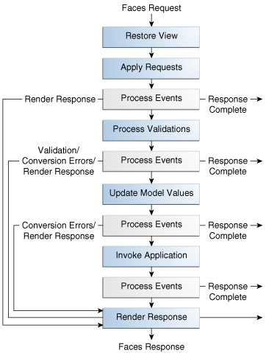
JSF2 considerations
JSF Lifecycle:
6 (or 10) phases,
executed at each
page
refresh/request

Slide 10
JSF2 considerations
JSF2 Backing beans have scopes:
@RequestScoped
@ViewScoped
@SessionScoped
@ApplicationScoped
@NoneScoped
@CustomScoped

Slide 11
JSF2 considerations
JSF2 facelets:
<ui:insert name=””>...</ui:insert> (use in template)
<ui:define name=””>...</ui:define>
<ui:include src=”” />
<ui:composition template=””>...</ui:composition>

Slide 12
JSF2 Primefaces - demo1

Slide 13
JSF2 Primefaces - demo2

Slide 14
JSF2 Primefaces - PrimeNG
Hans Van Es

